Slide 1

Performance Analysis-April
By Sandeep Yempaty
Jr. Commercial Planning Analyst

Slide 2
List of Topics
KPI-Extrapolation
Portfolio Status Visualization
Supply Planning for May Targets
Priotitizing Supplies on a category/Brand/SKU focusing on maximizing revenues.
Recommendations for Revenue Growth

Slide 3
Key Performance Indicators(KPIs) Utlization Percentage
Utilization Percentage : To measure the efficiency of our inventory management by comparing the number of Orders fulfilled to the amount of the stock we currently have on hand.
Higher Utilization % directs to effective utilization of our available stock to meet customer demand.
A lower % may indicate that we have excess stock relative to the orders we have received, which can lead to increased storage and handling costs, which can impact our revenue.
Notes:
Utlization Percentage = Orders / Stock in hand *100
Our interpretation is a Lower utilization percentage may suggest that there is excess stock in hand relative to the number of orders, which colud lead to higher Carring costs or inefficiencies in the inventory management.

Slide 4
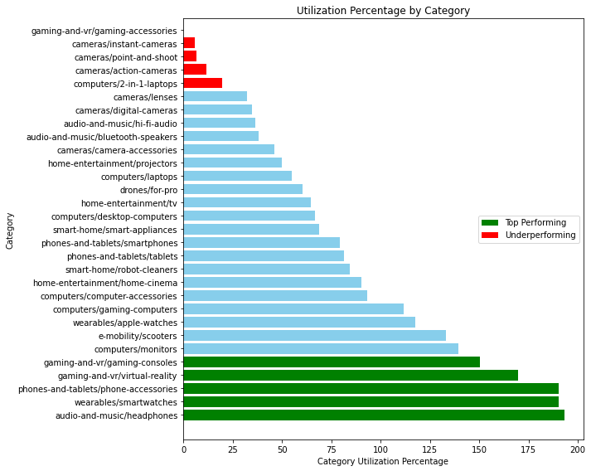

What was our avg utilization % in April ?
Overall, we have used 81.7 % of our stock to full fill customer orders during April.
Overall, our top-performing categories with highest utilization % include audio, wearables, phone accessories etc., have utilization above 100 % indicating strong demand and efficient stock management.
Gaming, Computers(2-in-1) laptops are underperforming.
To Further improve our Utilization % we must reconsider marketing strategies or adjust our stock quantities depending on the demand.

Slide 5
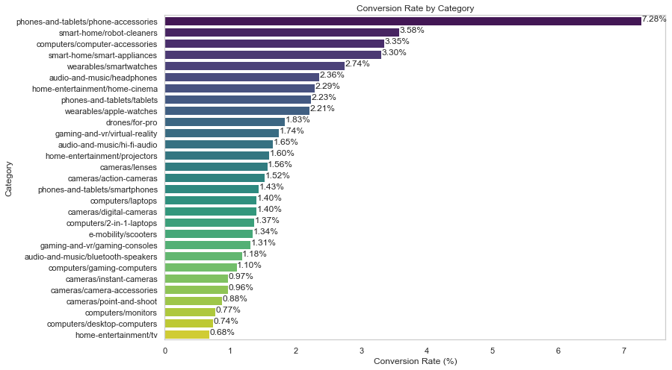
Analyzing conversion Rate – Unveiling customer Behaviour
One of the crucial metric to understand how effectively our platform is turning page views into customer orders.
Phones & tablets stand on top with a remarkable 7.28 % coversion rate. Suggesting strong purchase intent among visitors.
Home entertainment, deskotop computers exhibit lower conversion rates, indicating opportunites for imporvement.
Overall, conversion rate of 1.65 % alliging with industry benchmark.
Customised marketing plans should be made for the underperforming & avg performing categories, to further increase our overall conversion rate.

Slide 6
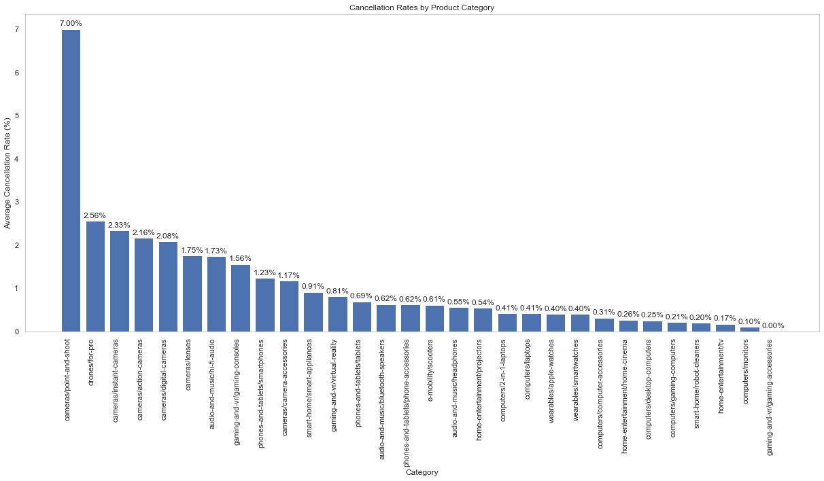
Cancellation Rate
Crucial metric in analyzing customer behaviour and our revenue growth.
Reflects our customer satisfaction and their perception of our products.
High Cancellation rate, will have a direct impact on revenue and profitability.
April‘s cancellation rate surged to 59.35 %, significantly higher than average cancellation rate.
As you can see in this graph, cameras have the highest cancellation rate percent. This is higher than the average cancellation rate for all products on our platform, which is around 2%.
Suggesting products which are expensive, and complex are having a high cancellation rate our platform.

Slide 7
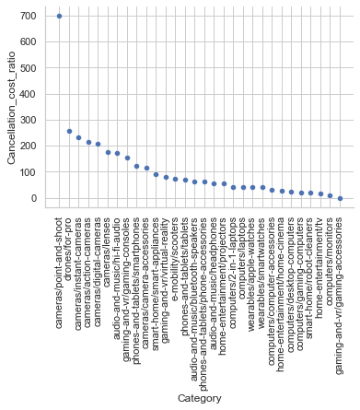
Cancellation Cost Ratio (%)
CCR measures the financial impact of order cancellations.
CCR = Revenue lost due to cancellations / Total Revenue.
Revenue lost due to cancellations = Avg Subscription price * Number of order cancellaions
In april, CCR reached 56 % indicating that substancial portion of revenue is impacted by cancellations.
Categories like cameras, audio, gaming, phones and tablets contributing to a greater part of the revenue loss.
Notes:
CCR = Revenue lost due to cancellations / total product revenue

Slide 8
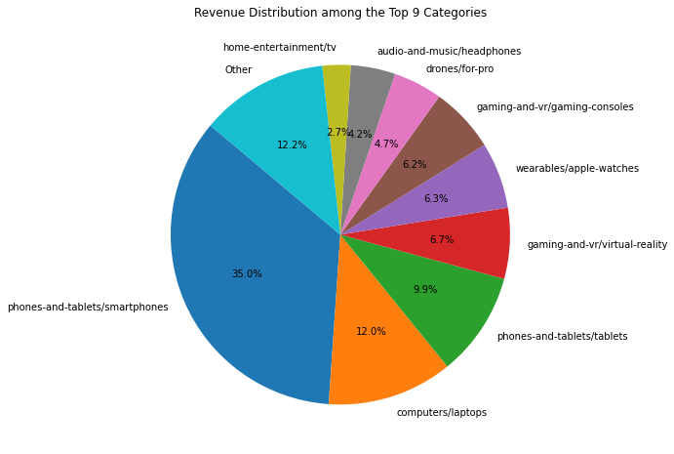
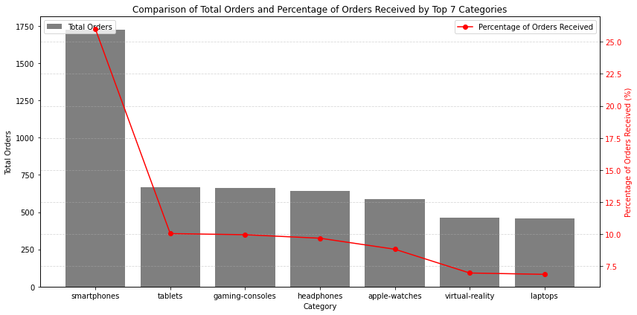

Portfolio Status Visulization
Order Analysis by Category
In the above figure y axis presents the abolute number of orders, and the right y axis shows the percentage of orders relative to the total, offering a perspective on how well each category performs in terms of attracting orders.
Above pie charts showing the distriubtion of revenue among the Top 9 categories and others.

Slide 9
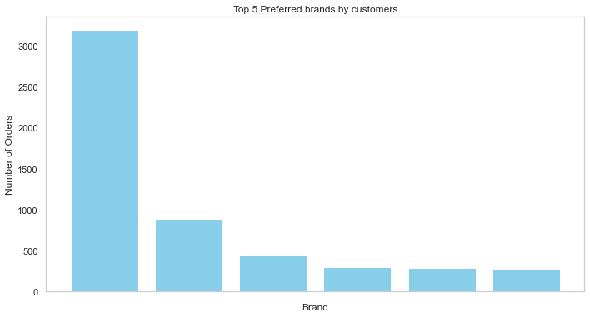




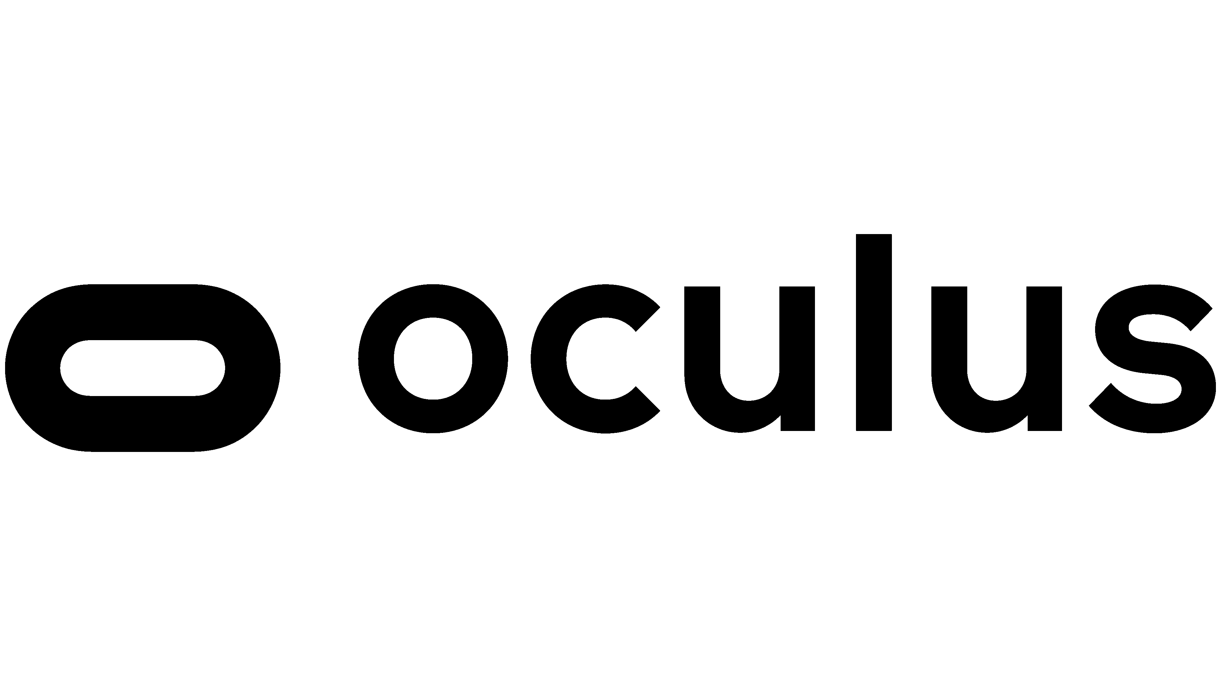

top preferred brands

Slide 10
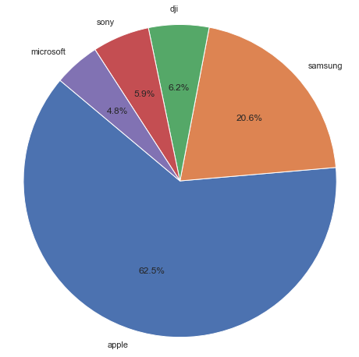
Top revenue generating Brands

Slide 11
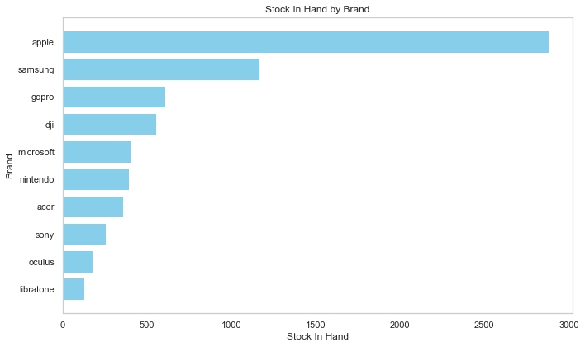
Brand Vs Stock In Hand

Slide 12
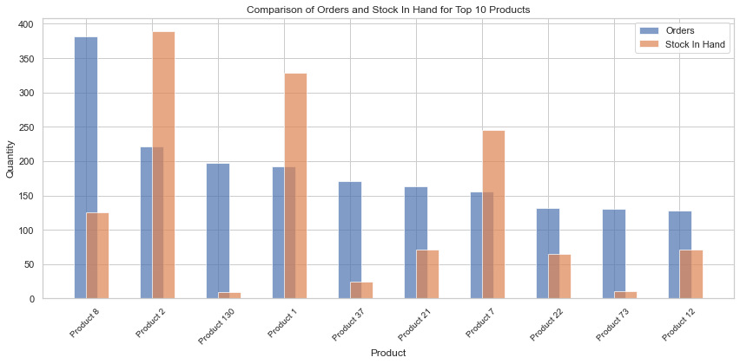
Most selling products

Slide 13
Supply Planning for May Targets
In the upcoming month of May, we are committed to maintaining a seamless supply chain that aligns with the expected demand across various product categories. To achieve this, we have analyzed the projected sales and our current stock levels for each category, as outlined in the table
The table provides a clear overview of what we anticipate in terms of sales and how well we are prepared with our existing inventory. The "Recommendation" column guides us in determining the actions we need to take to optimize our supply planning.
We are confident that by aligning our inventory with projected sales and remaining agile in our approach, we will successfully navigate the challenges and opportunities the month may bring.

Slide 14
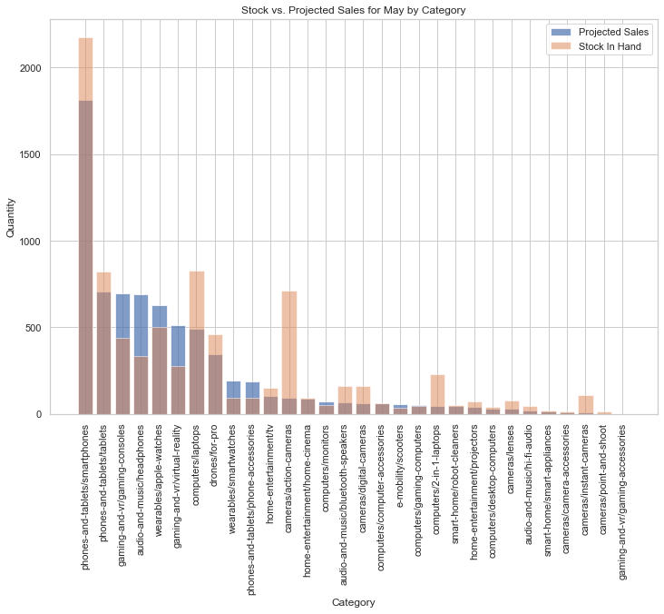
Stock Vs Projected Sales For May w.r.t categories

Slide 15
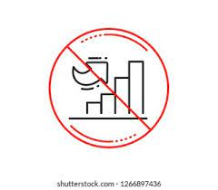
Supply planning Strategies for revenue maximization
Increase stock: In cases where projected sales signifacantly exceeded our current stock levels, it is advisable to increase our inventory to prevent any potential stockouts and meet customer demand effectively.
No Change: For categories with projected sales matching our current stock levels, our supply appears to be well-balanced, and no immediate adjustments are needed.
Category Level: We have identified product categories like Smartphones, tablets, laptops with consistent high demands. So, by allocating significant portion of our supply to these high demand categories we can ensure to meet customer orders promptly avoiding cancellations which can contribute to the revenue.
Brand Level: Apple, Samsung, Sony & dji are the top sellers with a loyal customer base. We should focus marketing efforts and promotions on these top performing brands to maximize sales and revenue.
Product level: Product 8, Product 2, Product 130, Product 1 etc., are the example SKUs with high sales. We should prioritize restocking of these best-selling SKUs to meet customer demand and capitalize on their popularity.

Slide 16


Recommendations
Strong positive correlation has been observed between page views and orders. personlized recommendations and dyanmic pricing should be encourged for better conversion rates which can increase the revenue.
Improving customer support to proactively address cancellation issues is a crucial step. Additionally, it's essential to conduct in-depth analysis to uncover the underlying reasons behind cancellations like customer cancelled, website issues etc.,
Reducing overstocking, for the less demand products, which can decrease the maintenance costs.
Focusing marketing efforts on underperforming brands and categories by creating targeted campaigns and promotions.
Overall, aligning our marketing strategies with the insights gained from our analysis offers a good chance of increasing revenue.

Slide 17

Thank you

